Slide 1
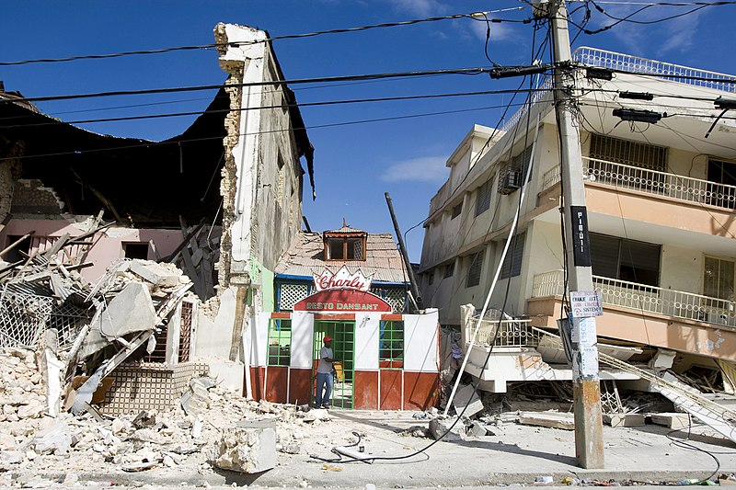

NLP for Disaster Relief
Berkeley AI4ALL
Photo Marco Dormino/ The United Nations

Slide 2
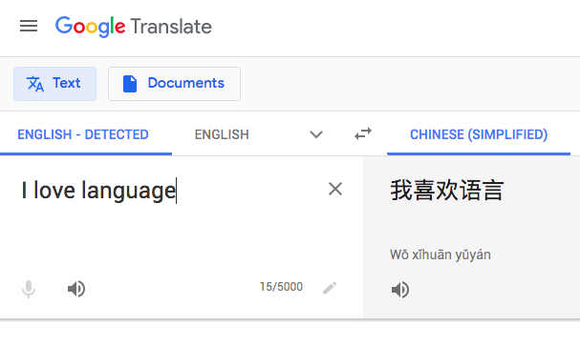

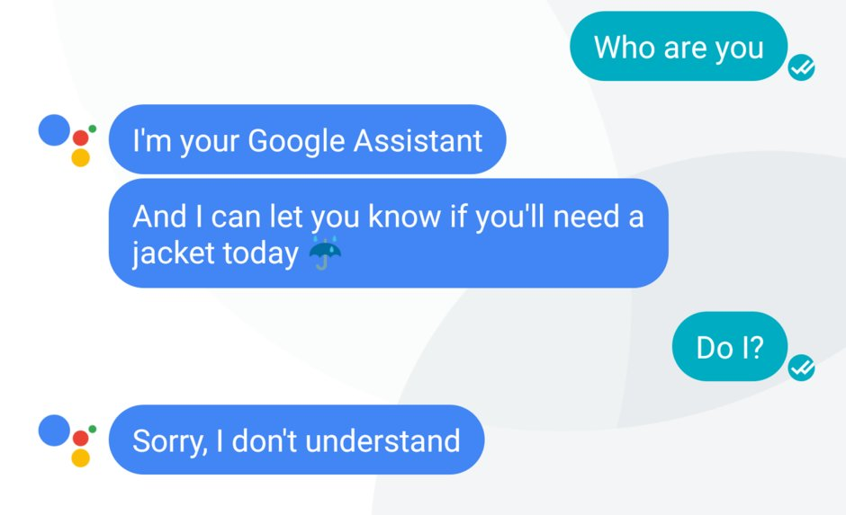
NLP = Natural Language Processing
Notes:
NLP is a field where computers process, understand, and generate language

Slide 3
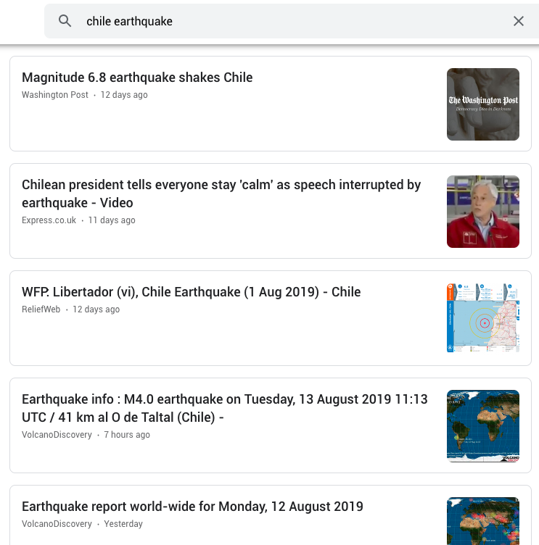

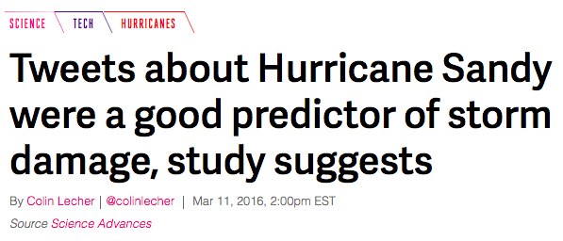

A lot of data is language!
Notes:
This kind of data includes text messages, tweets, and articles

Slide 4
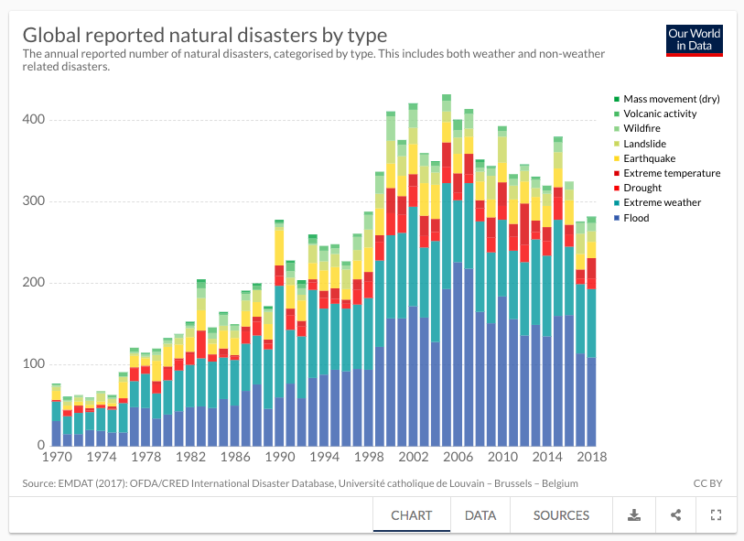
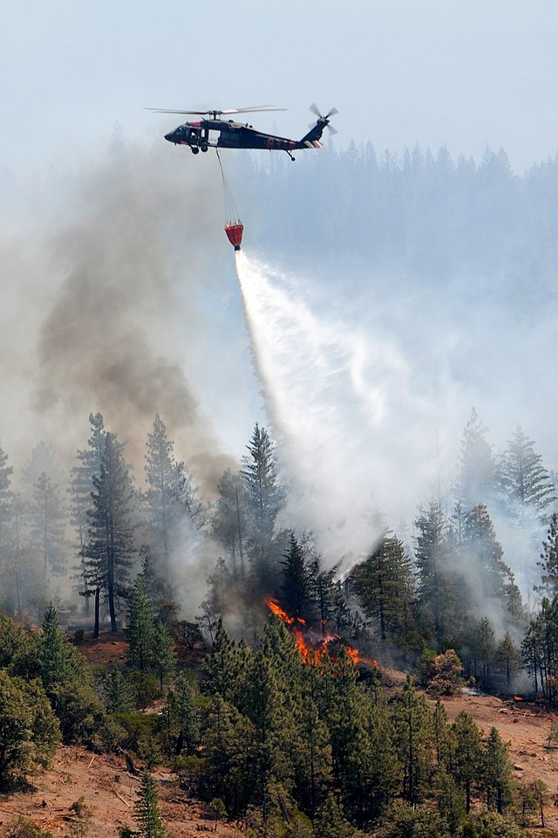
Background
Notes:
Every year, hundreds of natural disasters occur around the world. Some of these happen pretty close to home, such as the California wildfires last year.

Slide 5

Background
Natural disasters require efficient delivery of aid
We are at Gressier we needs assistance right away. ASAP, Come help us.
aid-related
Message
Notes:
Usually during a disaster, an actual human needs to read over every message received and determine whether it’s aid related or not.

Slide 6

Background
Natural disasters require efficient delivery of aid
We are at Gressier we needs assistance right away. ASAP, Come help us.
aid-related
Message
Notes:
We want to see if we can use AI to automate this process.

Slide 7
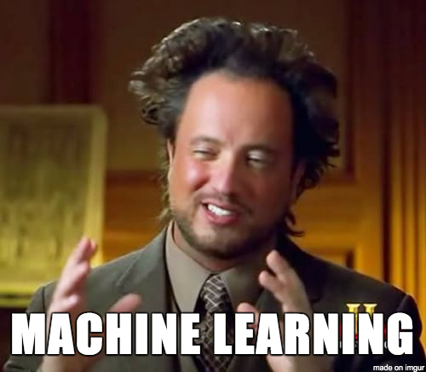
What you’ll be doing
Notes:
To do this, you’ll use machine learning models. You’ll learn how to implement your own evaluation functions and compare different models against each other.

Slide 8
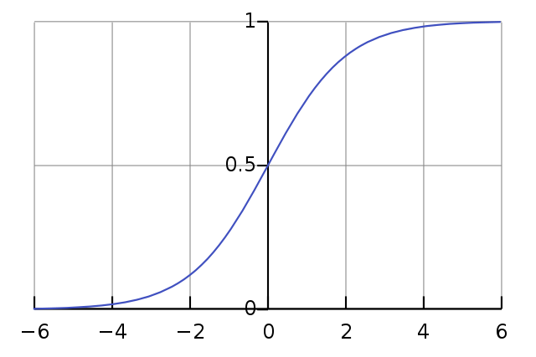

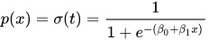
What you’ll be doing
Notes:
Specifically, we’ll use scikit-learn’s logistic regression model. We’ll tokenize our data and create vectors that represent each message. We’ll then classify each vector as aid-related or not.

Slide 9
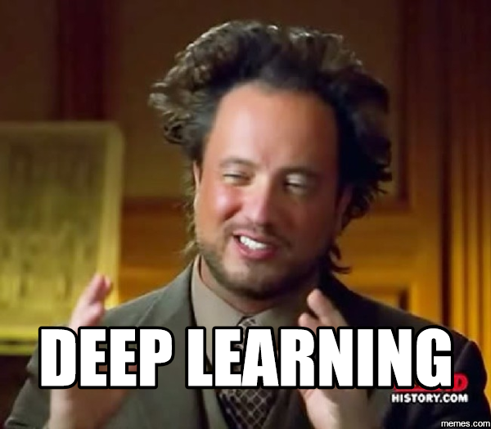
What you’ll be doing
Notes:
We’ll also build neural networks for our problem

Slide 10
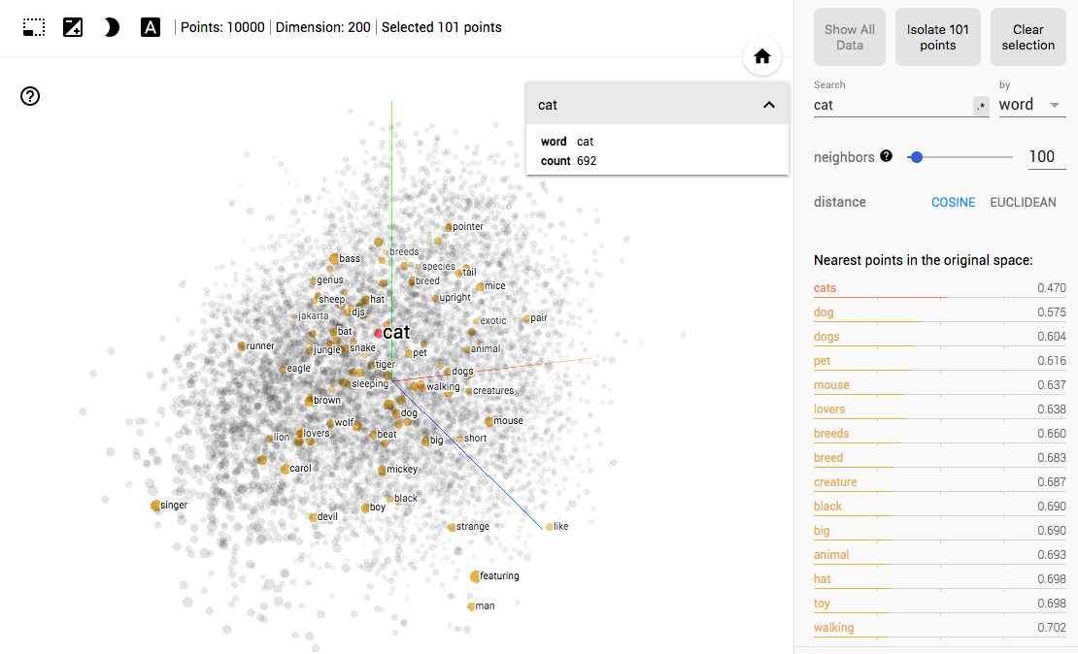
What you’ll be doing
Notes:
While we build our models, we’ll also look at how we can incorporate some common tools in NLP such as word vectors, which capture the meanings of words. [explain picture] Sequences of word vectors are often inputs into neural networks in NLP.

Slide 11

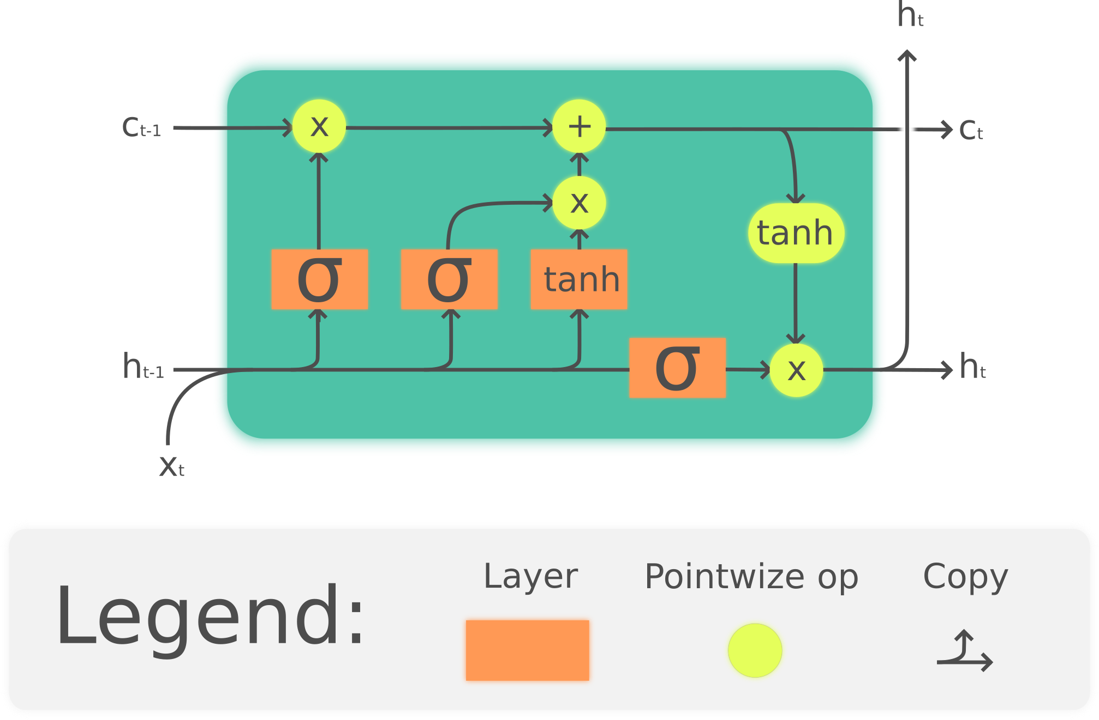
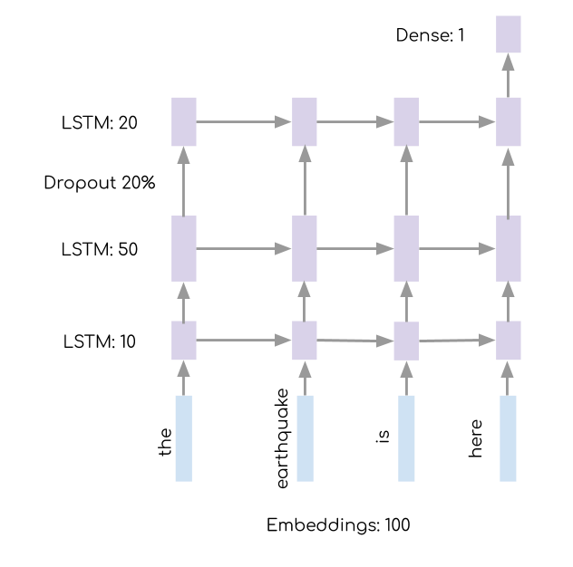
What you’ll be doing
Notes:
Specifically, we’ll learn how to stack LSTMs together with dropout regularization and word embeddings. It’s okay if you don’t know what any of these things mean right now. If you end up doing this project, you’ll learn all about these things. You’ll eventually design your own custom model and see how it compares to ours and each other’s! You’ll be using a package called Keras, which is a package that real AI researchers use in their own work.

Slide 12
Thanks!
Notes:
That was a quick summary of the disaster relief project

